Slide 1
E-learning platforms and new tools to enhance teaching and learning experiences
eLearning Update Jun 2017

Slide 2
Outline
LMS
KEEP
O365
LRS
Content Resources
Summer Upgrade
New features
Office Mix
Sway
OneNote
OneNote Class Notebook
One Drive
Publisher Content
Library Resources

Slide 3
E-learning platforms and new tools to enhance teaching and learning experiences
eLearning Update Jun 2017

Slide 4
PART 1

Slide 5
LMS
Notes:
http://www.cuhk.edu.hk/eLearning/c_systems/blackboard/info2017.html
Create Course - Five Steps
https://help.blackboard.com/Learn/Instructor/Getting_Started/Where_Do_I_Start#steps
Best practices for student interactions
https://help.blackboard.com/Learn/Instructor/Interact/Best_Practices
Best practices for course content
https://help.blackboard.com/Learn/Instructor/Course_Content/Best_Practices_Course_Content
Best practices for tracking performance
https://help.blackboard.com/Learn/Instructor/Performance/Best_Practices

Slide 6
KEEP
Notes:
https://keep.edu.hk/
https://course.keep.edu.hk/
https://course.keep.edu.hk/submitCourse

Slide 7
E-learning platforms and new tools to enhance teaching and learning experiences
eLearning Update Jun 2017

Slide 8
PART 2

Slide 9
O365
Notes:
https://www.cuhk.edu.hk/o365/
http://www.itsc.cuhk.edu.hk/en-gb/all-it/email-messaging-and-collaboration/office-365-proplus
http://www.itsc.cuhk.edu.hk/en-gb/student-it/email-messaging-and-collaboration/onedrive-for-business
http://www.itsc.cuhk.edu.hk/en-gb/staff-it/email-messaging-and-collaboration/office-365-mail
http://www.itsc.cuhk.edu.hk/en-gb/application-forms
http://www.itsc.cuhk.edu.hk/images/content/app_form/acc_project.docx
https://support.office.com/en-us/article/Office-Training-Center-b8f02f81-ec85-4493-a39b-4c48e6bc4bfb
https://support.office.com/en-us/article/Office-Quick-Starts-25f909da-3e76-443d-94f4-6cdf7dedc51e?ui=en-US&rs=en-US&ad=US

Slide 10
OneDrive
Notes:
https://www.cuhk.edu.hk/itsc/o365/onedrive/onedrive-web.pdf

Slide 11
Office Mix
Notes:
https://mix.office.com

Slide 12
Notes:
https://mix.office.com/gallery/category/how-to

Slide 13
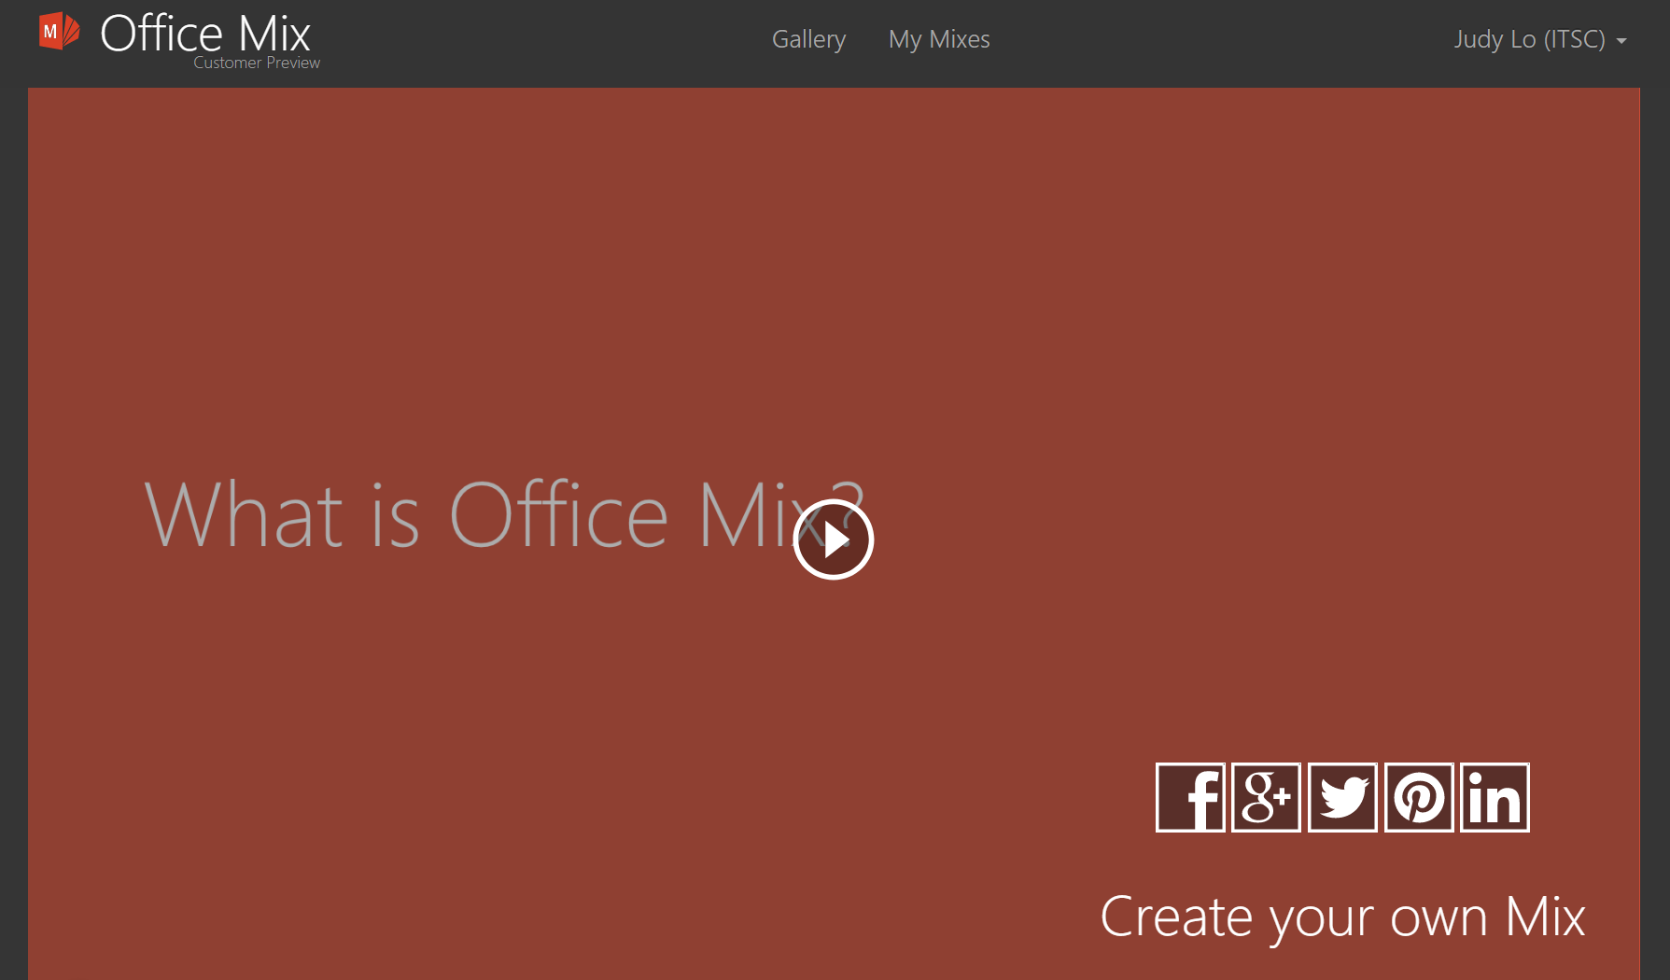
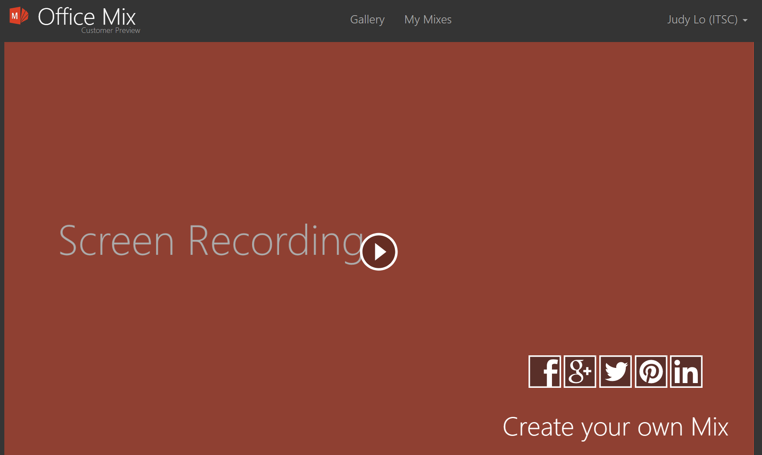
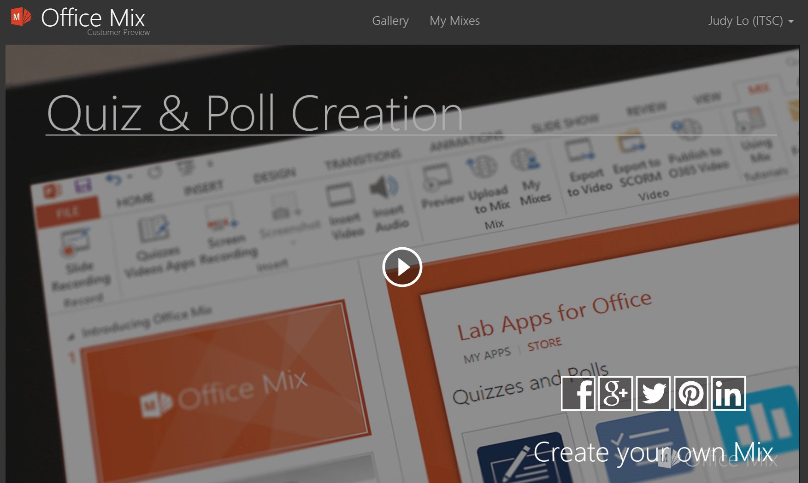
Notes:
https://mix.office.com/gallery/category/how-to
https://mix.office.com/watch/atzf2r2ulc2o?play
https://mix.office.com/watch/sqc2mb5w1s5z?play
https://mix.office.com/watch/j2egqmszktjh?play
https://mix.office.com/watch/a9s0mkg6oyl9

Slide 14
Sway
Notes:
https://sway.com
https://www.youtube.com/watch?v=pcg6DGO9hpI&list=PLXPr7gfUMmKyE22-YpbgcDfr2SXEO7-qX&index=1
https://sway.com/OrAD84VioQFcaAOW?ref=Link&loc=mysways
https://sway.com/nItQ5q8FBlgwgWl4?ref=Link&loc=mysways
https://sway.com/Uj5KTesAQtoz8uuW?ref=Link&loc=mysways
https://sway.com/zBGKBUJT3xEFKOHv?ref=Link&loc=mysways

Slide 15
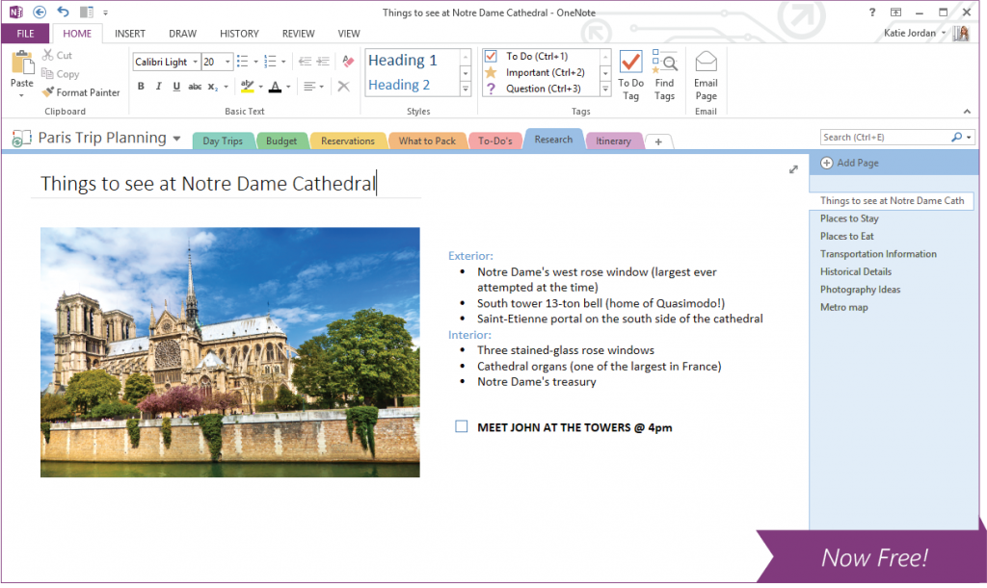
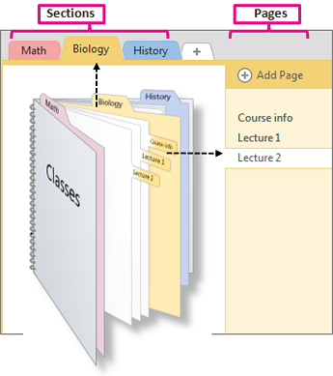
OneNote
Notes:
https://www.microsoft.com/en-us/education/products/onenote/default.aspx?SearchType=0
https://support.office.com/en-us/article/OneNote-2016-Training-51d1d95b-bdf4-48df-acad-a3331dec8f97

Slide 16
OneNote Class Notebook
Notes:
http://onenoteforteachers.com/en-US/Guides/Collaborating%20in%20the%20classroom%20with%20the%20OneNote%20Class%20Notebook%20Creator

Slide 17
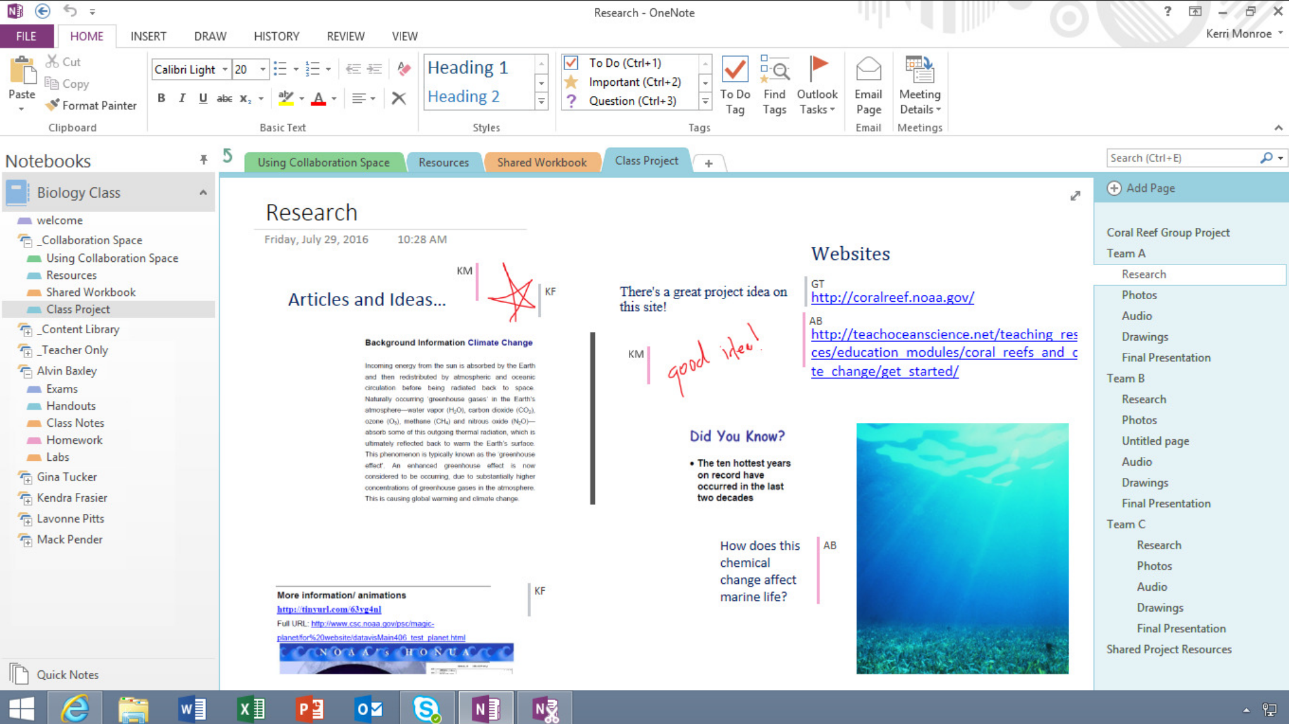

Slide 18
E-learning platforms and new tools to enhance teaching and learning experiences
eLearning Update Jun 2017

Slide 19
PART 3

Slide 20
LRS

Slide 21
E-learning platforms and new tools to enhance teaching and learning experiences
eLearning Update Jun 2017

Slide 22
PART 4

Slide 23
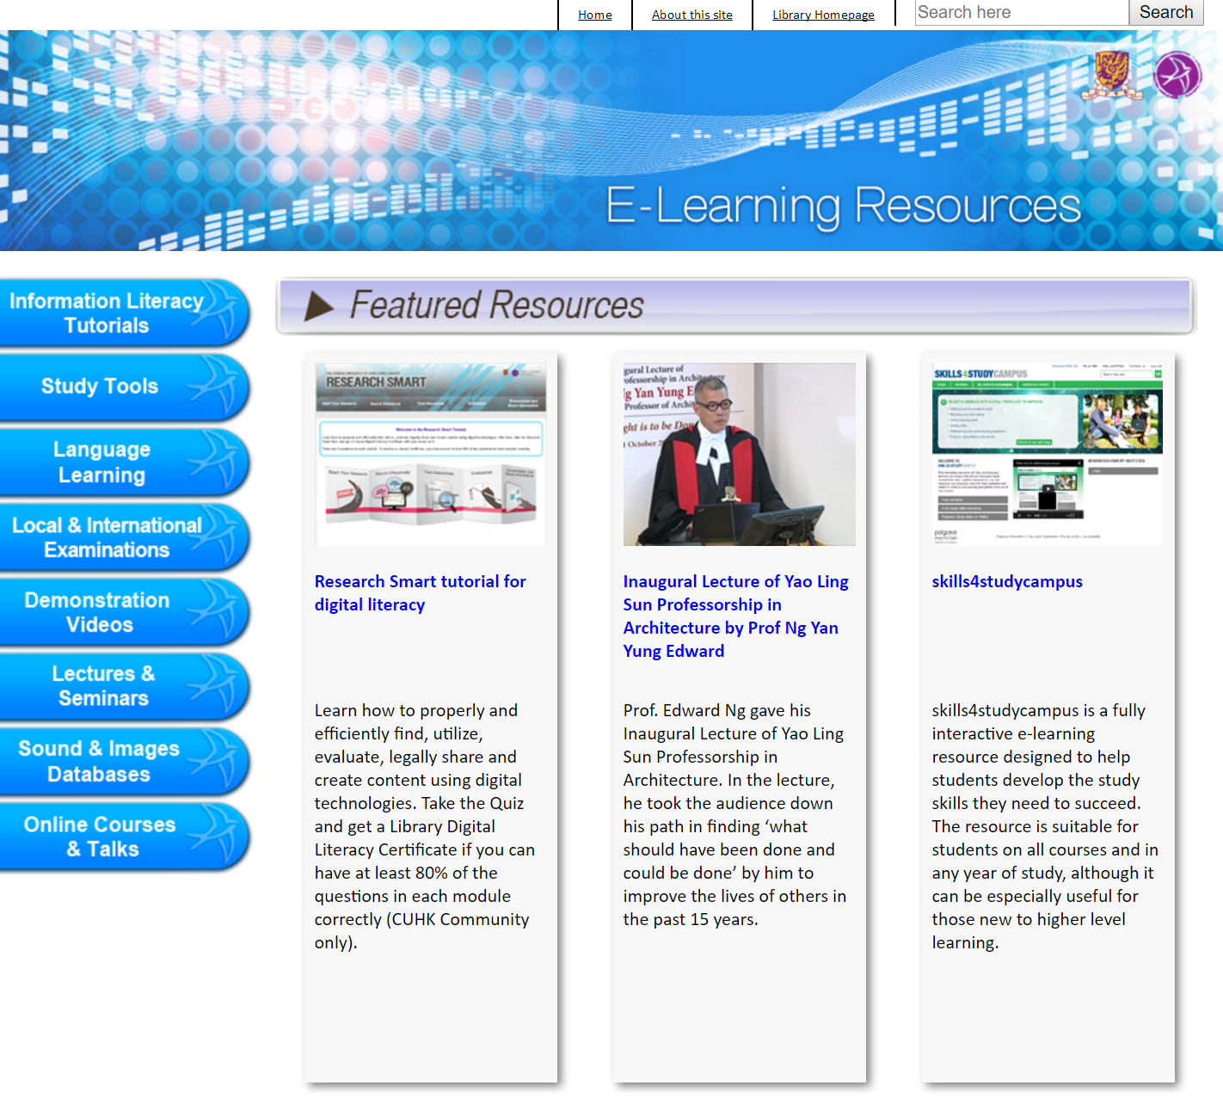
Content Resources
Publisher Content (Blackboard)
Library eLearning Resources
Notes:
http://www.blackboard.com/partnership/featured-partners.aspx
http://elearning.lib.cuhk.edu.hk/

Slide 24
E-learning platforms and new tools to enhance teaching and learning experiences
eLearning Update Jun 2017

Slide 25
PART 5

Slide 26
Stay tuned

Slide 27
Thank you
elearning.cuhk.edu.hk
elearning@cuhk.edu.hk
Jun 4, 2017
Notes:
http://elearning.cuhk.edu.hk
elearning@cuhk.edu.hk

