Slide 1
Real-time Auto-captioning Service for Students with SEN
The Centre for sign linguistics and deaf studies (cslds)

Slide 2
Project Objective
Identify the needs of SEN students in information accessibility in an academic setting
How SEN students could potentially benefit from real-time auto-captioning to fill their gaps of needs
An evaluation on the technology capability and user experience of the trial service
How the university could make use of such technology to support SEN students effectively

Slide 3
Activities, process and outcomes
User Experience Testing
Trials in online learning
Technical Testing
By CSLDS
By EE
evaluated effectiveness of auto-captioning by collecting users’ feedback
Questionnaire surveys
evaluated the overall technical capability and the accuracy rates of two real-time auto-captioning software
Focus group discussions

Slide 4
Demonstrations of Captioning Tools
Zoom auto-captioning

Slide 5
Students contacted/supported so far
Total：9 students
1 DHH had no trial in class after demonstration
1 DHH Master’s student preferred using FM system
1 part-time, DHH student doing a Master degree in Psychology student was supported bythe Pedius system but felt dissatisfied
2020-2021
Sem 2
No. of Students | 6
Courses Involved | 10
2021-2022
Sem 1
No. of Student | 3
Courses Involved | 9

Slide 6
Type of SEN | Learning needs in the learning process | Current self-help solutions | Problems of the self-help solution
Hearing Impairment (Moderate and bilateral hearing loss) | Sometimes cannot hear clearly Face to face: two many different types of sounds in the lecture hall --> fail to concentrate on speech sounds due to presence of noises Zoom: low sound quality of microphones Hard to read lips as the speaker’s mouth is covered with a mask Hard to hear clearly when the speech sounds overlap in group discussions | Ask the lecturer/ classmates after class Read lecture notes Use of a bluetooth hearing aid which connects directly to the computer audio | Hard to effectively communicate with lecturers and classmates, especially in an online mode Some important contents may not be included in the lecture notes
ADHD | Will easily lose focus/ got distracted, especially in a 2-3 hr long lesson Hard to focus if slow speaking speed | Upload recorded lectures to YouTube for auto captioning Watch recordings in fast speed mode after lessons Find other online tutorial videos and do self-revision | Recordings not allowed in some lessons Susceptible to copyright infringement through unauthorized recordings or upload of videos
ADHD + Dyslexia | Have to spend a lot of time on reading long passages | Catch up with learning progress through external learning materials Use text-to-speech tools to help reading long passages
Asperger Syndrome | Hard to focus, especially in lessons conducted via Zoom Hard to follow or participate in group discussions | Ask teachers to speak slowly Read lecture notes on their own | Speed of speech delivery of lecturers varies and hard to accommodate for all Some important contents are not written in the lecture notes/ some lectures do not provide lecture notes

Slide 7
Dissemination, diffusion, impact and sharing of good practices
User-case reports
- based on the users’ feedback and technical evaluation
- good reference for further review of other captioning systems
Sharing of experiences
- help different departmental representatives understand the potential benefits of auto-captioning service to SEN students.

Slide 8
STUDENT FEEDBACK
Through focus group discussion & questionnaire

Slide 9
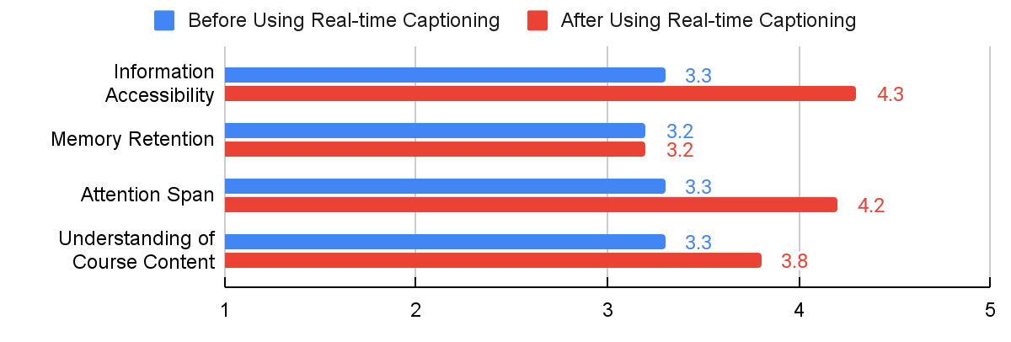
Rating on Effectiveness of Captioning (Student)

Slide 10
User Feedback
Auto-captioning tools with satisfying performance is helpful in enhancing the attention and information accessibility of students with AD/HD and moderate hearing impairment.
Students with severe to profound hearing impairment may need other kinds of support at the same time, such as sign interpretation or real-time captions by stenographers.
Students prefer Zoom to Pedius in view of the former’s higher accuracy rate and faster processing time, only that Zoom does not offer Cantonese captions.

Slide 11
Use-case report
Technical review by the team of prof Tan lee

Slide 12
Area of testing: Cantonese (code-mixed) captions
Accuracy (based on recordings of 4 lectures):
3 error types: Substitution, Insertion, Deletion
Cantonese captions produced by Pedius system:
Overall accuracy rate: 76.4%
Average character error rate : 23.6%
Error rate of English words in Cantonese-English
code-mixed utterances: 76.5%

Slide 13
Area of testing: Eng captions
English captions produced by both Zoom and Pedius
Average character error rate :
Pedius: 49.0%
Zoom: 23.9%
Processing time
Comparing the onset/offset time of speech and captions:
Pedius: 1.60s (showing most confident transcriptions)
Zoom: 0.46s (procedural approach of captioning)

Slide 14
Conclusion:
The results of this project show that auto-captioning is a support measure that can enhance effectiveness of online learning of different types of SEN students.
It is necessary to raise teachers’ and SEN students’ awareness on the potential benefits of captioning service to students’ learning

Slide 15
Practical suggestions
1. Performance of Captioning Tool:
“Real-time” captioning with a significant delay and low accuracy might not benefit the students and even interfere with learning. The accuracy rate of captions should be high enough (>90%) and the output of captions should be within 1 second.
2. Supported Languages:
The captioning tools in use should be able to identify the commonly used languages for teaching at the University, including code-mixed-language situations (e.g. Cantonese & English).

Slide 16
Practical suggestions
3. User Friendliness:
The operations should be as simple as possible, so that instructors are more willing to turn on the captioning tool during the lessons. Guidelines for operations should be written clearly for departments’ and teachers’ reference.
4. Privacy & Security:
As many teachers are concerned about leakage of class contents, the transcripts/ captioned contents should be restricted to use by the target students, i.e., the permitted third party.

Slide 17
Deliverables and evaluation
Deliverables
http://cslds.org/v4/captioning.php
upload to CSLDS’s website
Simple Guideline
for future support of SEN students
Demo Video
provide to OSA & ITSC
(showing how to use auto-captioning in class)

Slide 18
Webpage under CSLDS for Users’ Reference
http://cslds.org/v4/captioning.php

Slide 19
Demonstration Video of the Captioning System of Zoom

Slide 20
Future Plan
1. Evaluate how real-time captioning functions in different pedagogical settings
⇒ mass lectures, tutorials (group or individual), and group discussions
2. Explore different service systems involving post-lecture video captioning

Slide 21
END

